Slide 1




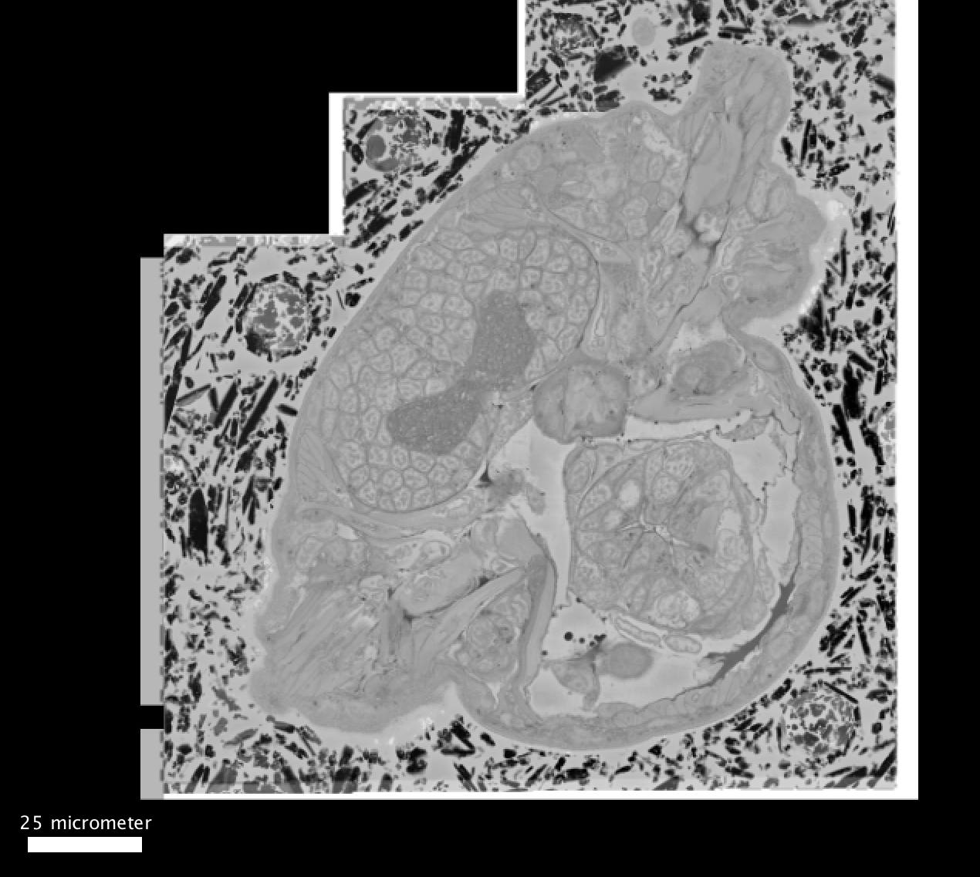
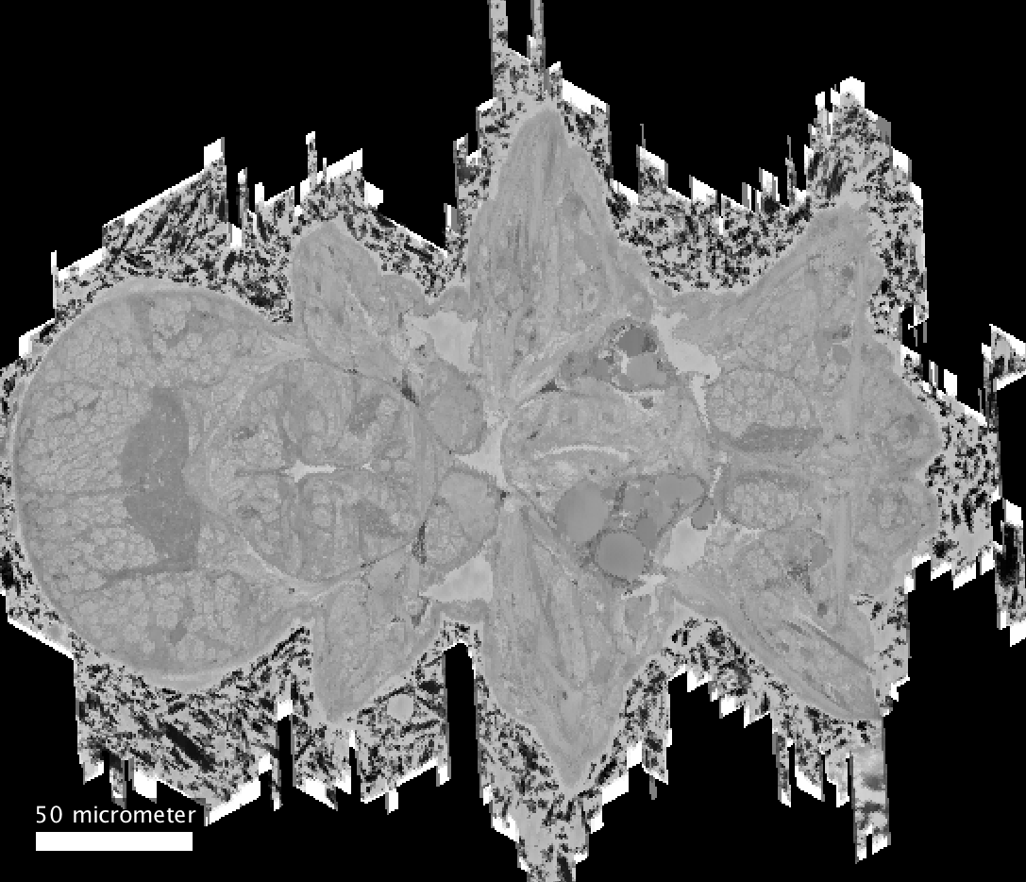
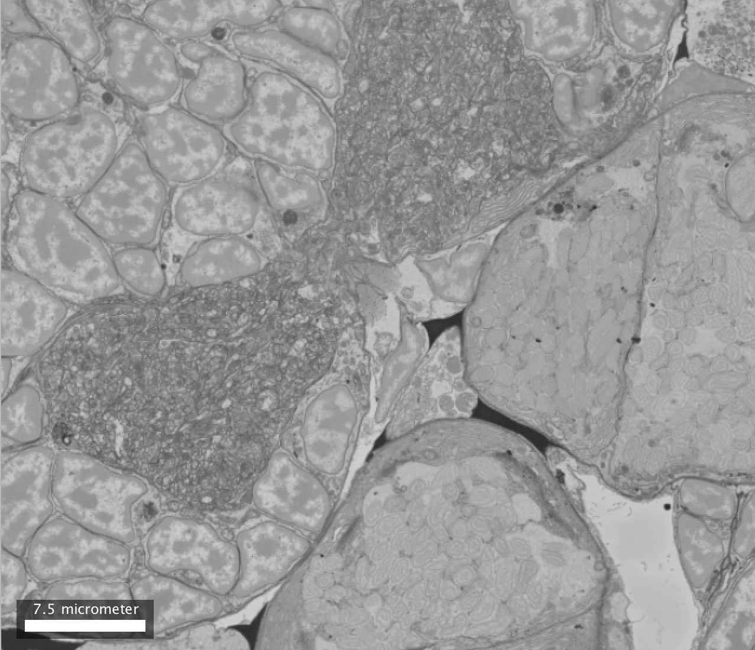

Slide 4
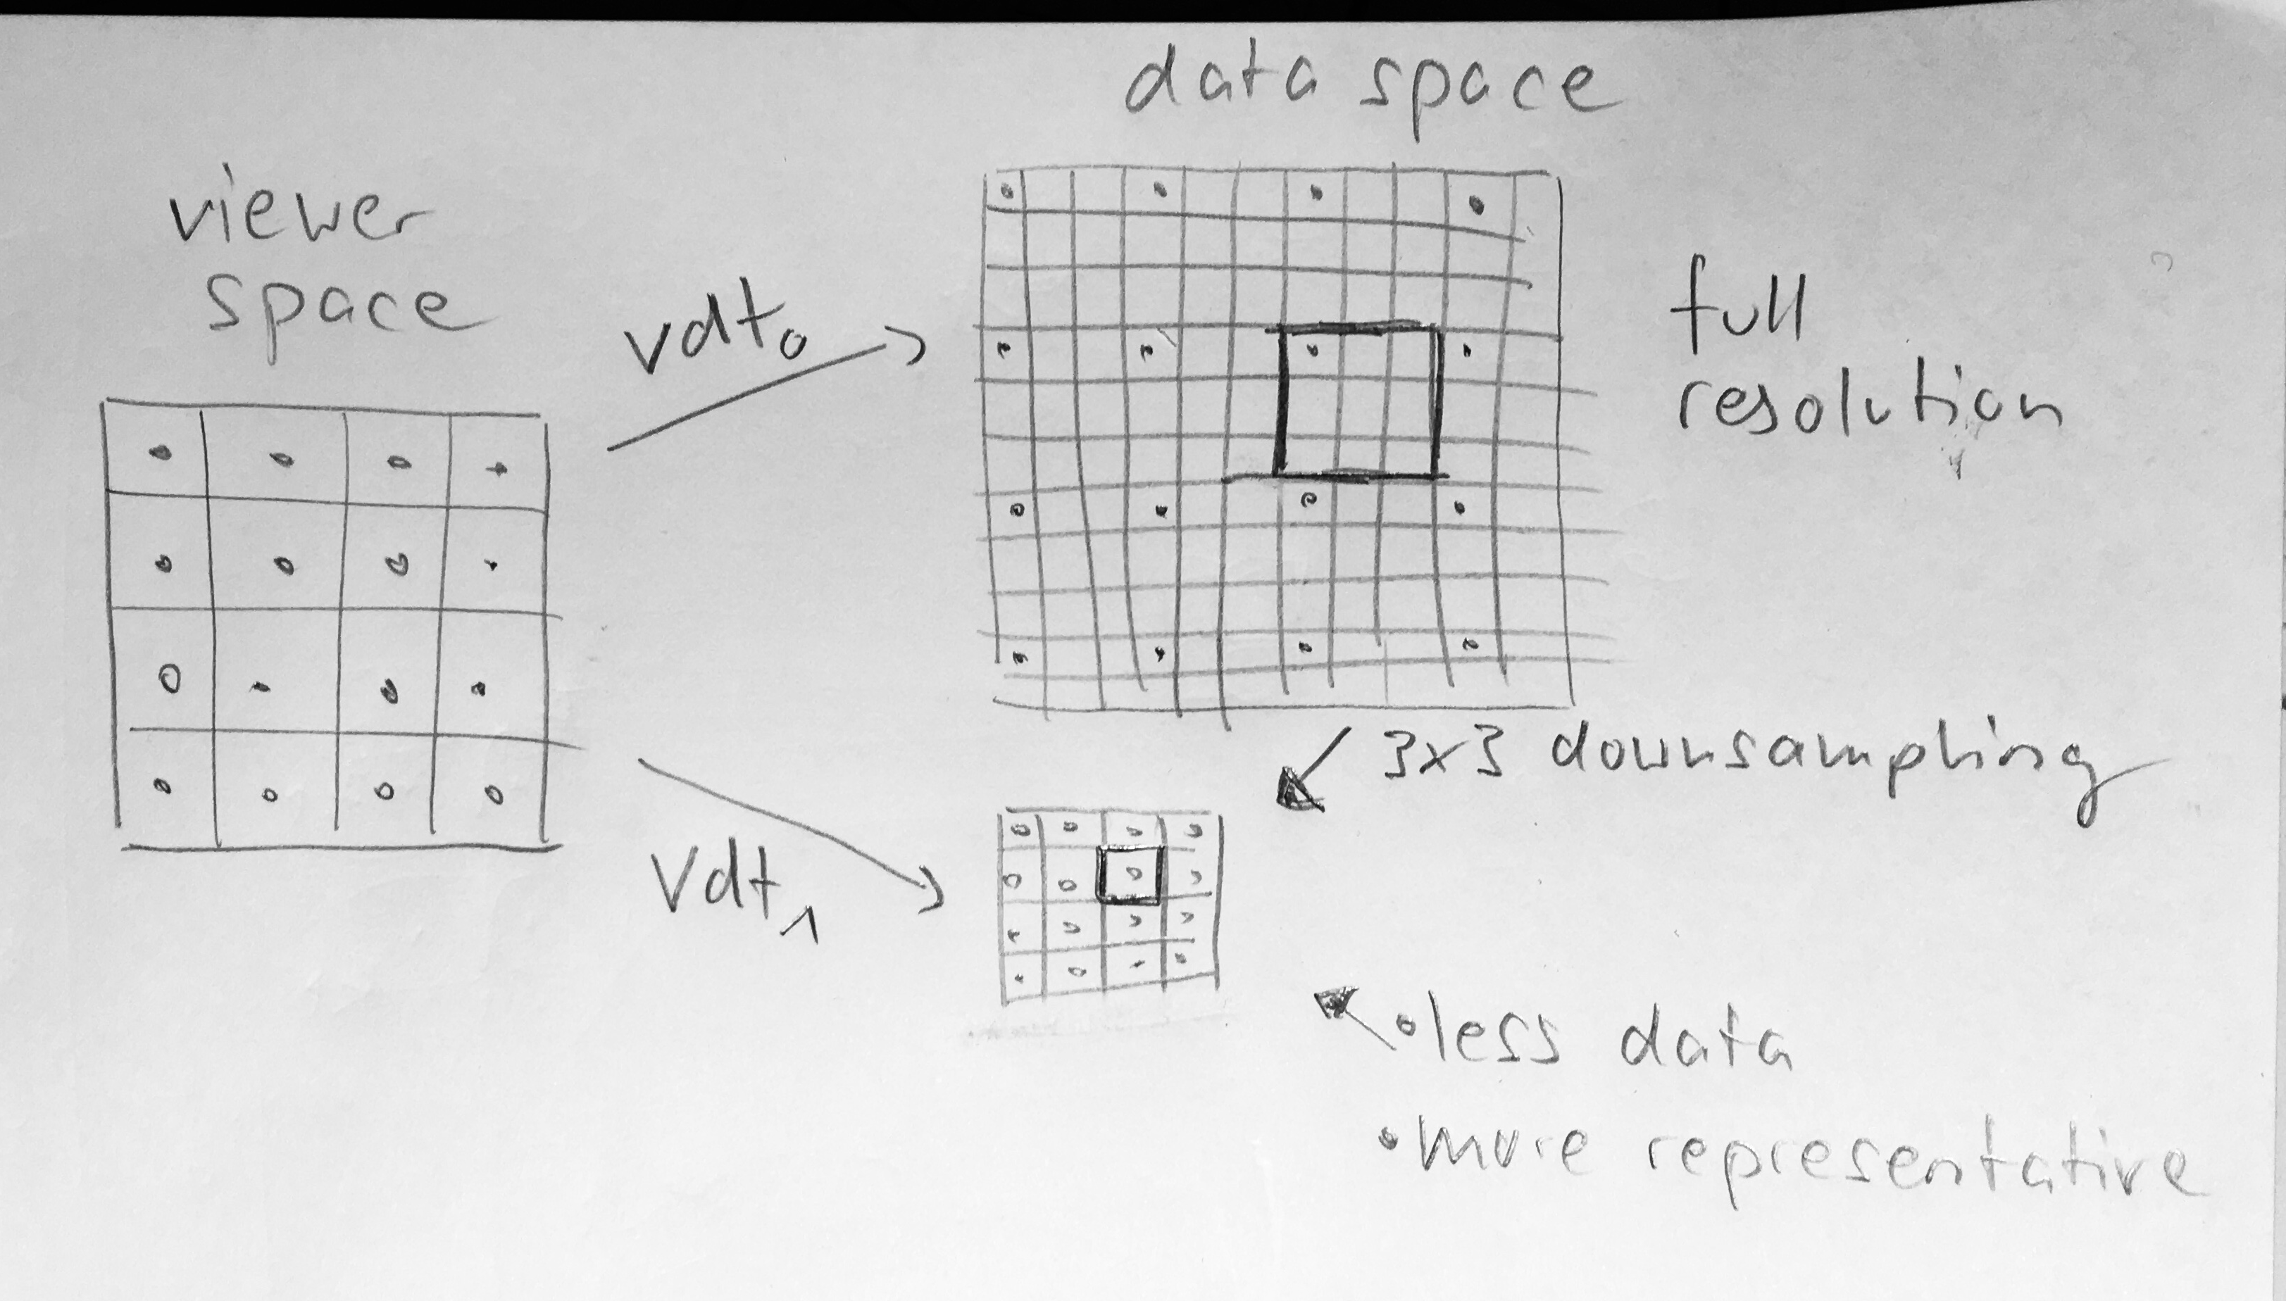
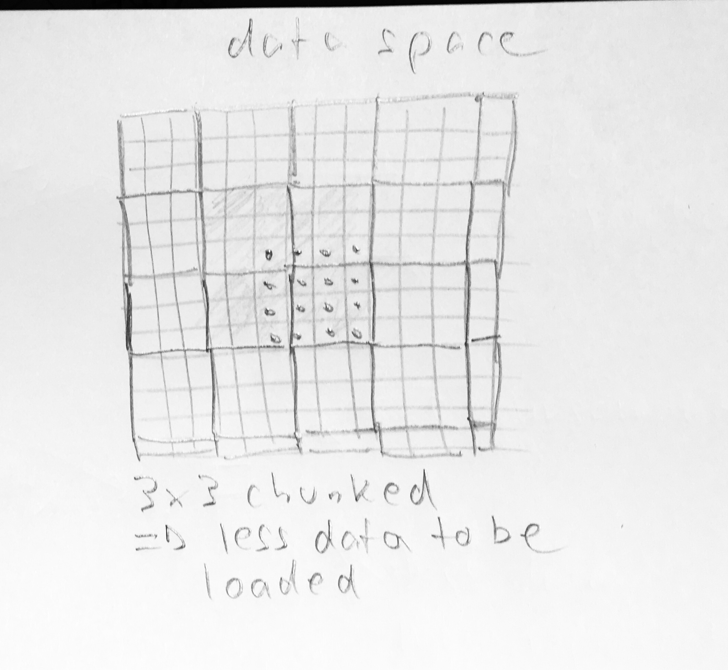
zoom in

Slide 5
Metadata
Resolution 1
Resolution 2
1010101…10000000000…100000000010001010…000101000000201000…10010000010001010…10000010……………010001010…1000001
…
Image dimensions (r)
Chunk dimensions (r)
Pixel physical size (r)
2 x 2
Down-sampling
Row chunking
Chunk height
Chunk width

Slide 6
Metadata
…
Image dimensions (r)
Chunk dimensions (r)
Pixel physical size (r)
Resolution 1
Resolution 2
10101100………00000000…100000000010001010…000101000000201000…10010000010001010…10000010……………010001010…1000001
2 x 2
Down-sampling
Chunk height
Row chunking
Chunk width

Slide 7
Metadata
Resolution 0
Resolution 1
1110010101100………00000000…100000000010001010…000101000000201000…10010000010001010…10000010……………010001010…1000001
Down-sampling
Row chunking
Square chunking
Metadata
Pixel data type
Offset to pixel data
Number of resolutions
Image dimensions (r)
Chunk dimensions (r)
Pixel physical size (r)
…

